Slide 1
Ensemble Methods
Lecture 7

Slide 2
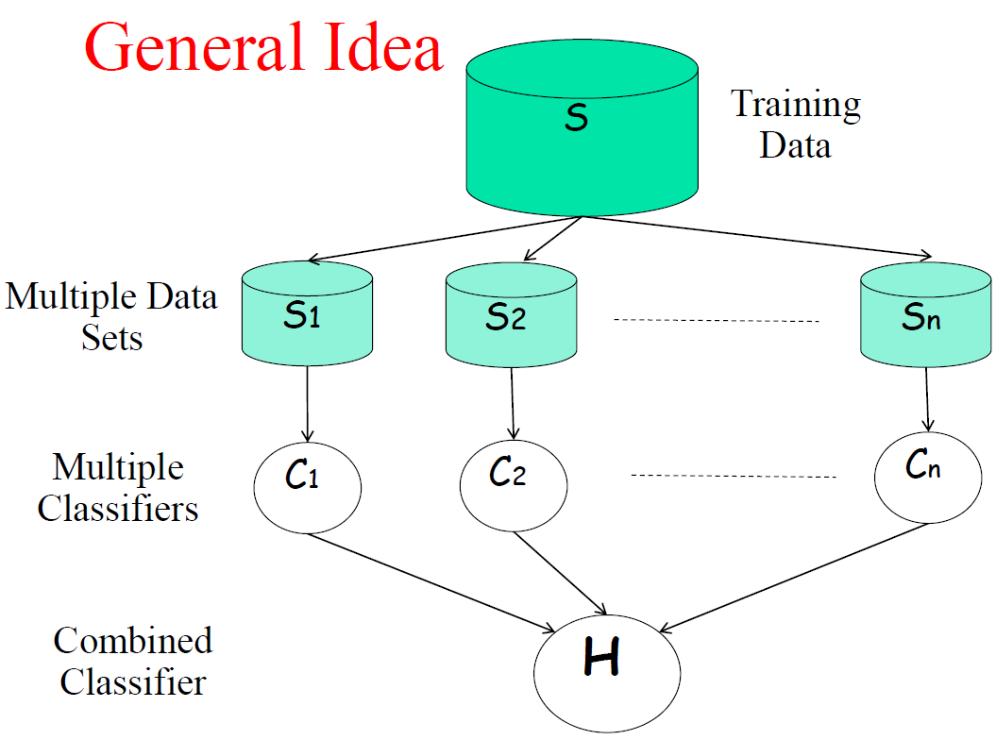

Slide 3
Build Ensemble Classifiers
Basic idea:
Build different ”experts”, and let them vote
Advantages:
Disadvantages:

Slide 4
Build Ensemble Classifiers
Basic idea:
Build different ”experts”, and let them vote
Advantages:
Improve predictive performance
Other types of classifiers can be directly included
Easy to implement
Not too much hyperparameter tuning
Disadvantages:
Poor interpretability (black box)
Not a compact representation
Computationally expensive inference (why?)

Slide 5
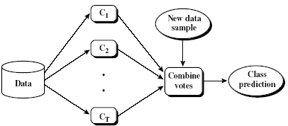
Ensemble Methods: Increasing the Accuracy
Ensemble methods
Use a combination of models to increase accuracy
Combine a series of k learned models, M₁, M₂, …, M_{k}, with the aim of creating an improved model M*
Popular ensemble methods
Bagging: averaging the prediction over a collection of classifiers
Boosting: weighted vote with a collection of classifiers
Ensemble: combining a set of heterogeneous classifiers
5

Slide 6
Ensemble Methods
Bagging (Breiman 1994)
Boosting (Freund and Schapire 1995 , Friedman et al. 1998
Random forests (Breiman 2001)
Predict class label for unseen data by aggregating a set of predictions (classifiers learned from the training data).

Slide 7
Bagging: Boostrap Aggregation
Analogy: Diagnosis based on multiple doctors’ majority vote
Training
Given a set D of d tuples, at each iteration i, a training set D_{i} of d tuples is sampled with replacement from D (i.e., bootstrap)
A classifier model M_{i} is learned for each training set D_{i}
Classification: classify an unknown sample X
Each classifier M_{i} returns its class prediction
The bagged classifier M* counts the votes and assigns the class with the most votes to X
Regression: can be applied to the prediction of continuous values by taking the average value of each prediction for a given test tuple
Accuracy
Often significantly better than a single classifier derived from D
For noise data: not considerably worse, more robust
Proved improved accuracy in prediction
7

Slide 8
When does Bagging work?
Learning algorithm is unstable: if small changes to the training set cause large changes in the learned classifier.
If the learning algorithm is unstable, then Bagging almost always improves performance
Bagging works because it reduces variance by voting/averaging
Some candidates:
Decision tree, decision stump, regression tree, linear regression, SVMs

Slide 9
Boosting
Analogy: Consult several doctors, based on a combination of weighted diagnoses—weight assigned based on the previous diagnosis accuracy
How boosting works?
Weights are assigned to each training tuple
A series of k classifiers is iteratively learned
After a classifier M_{i} is learned, the weights are updated to allow the subsequent classifier, M_{i+1}, to pay more attention to the training tuples that were misclassified by M_{i}
The final M* combines the votes of each individual classifier, where the weight of each classifier's vote is a function of its accuracy
Boosting algorithm can be extended for numeric prediction
Comparing with bagging: Boosting tends to have greater accuracy, but it also risks overfitting the model to misclassified data
9

Slide 10
Adaboost (Freund and Schapire, 1997)
Given a set of d class-labeled tuples, (X₁, y₁), …, (X_{d}, y_{d})
Initially, all the weights of tuples are set the same (1/d)
Generate k classifiers in k rounds. At round i,
Tuples from D are sampled (with replacement) to form a training set D_{i} of the same size
Each tuple’s chance of being selected is based on its weight
A classification model M_{i} is derived from D_{i}
Its error rate is calculated using D_{i} as a test set
If a tuple is misclassified, its weight is increased, o.w. it is decreased
Error rate: err(X_{j}) is the misclassification error of tuple X_{j}. Classifier M_{i} error rate is the sum of the weights of the misclassified tuples:
The weight of classifier M_{i}’s vote is

Slide 11
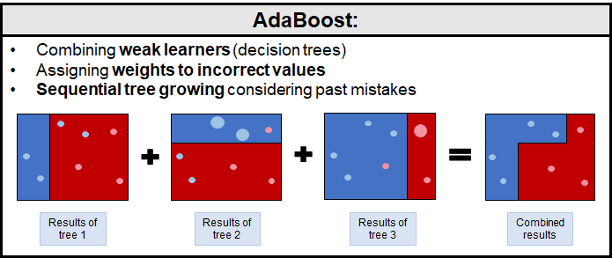
Adaboost (Freund and Schapire, 1997)

Slide 12
Random Forest (Breiman 2001)
Random Forest:
Each classifier in the ensemble is a decision tree classifier and is generated using a random selection of attributes at each node to determine the split
During classification, each tree votes and the most popular class is returned
Two Methods to construct Random Forest:
Forest-RI (random input selection): Randomly select, at each node, F attributes as candidates for the split at the node. The CART methodology is used to grow the trees to maximum size
Forest-RC (random linear combinations): Creates new attributes (or features) that are a linear combination of the existing attributes (reduces the correlation between individual classifiers)
Comparable in accuracy to Adaboost, but more robust to errors and outliers
Insensitive to the number of attributes selected for consideration at each split, and faster than bagging or boosting
12

Slide 13

Random Forest (Breiman 2001)
13

Slide 14
Random Forests
Random forests (RF) are a combination of tree predictors
Each tree depends on the values of a random vector sampled independently
The generalization error depends on the strength of the individual trees and the correlation between them
Using a random selection of features yields results favorable to AdaBoost, and are more robust w.r.t. noise

Slide 15
The Random Forests Algorithm
Given a training set S
For i = 1 to k do:
Build subset Si by sampling with replacement from S
Learn tree Ti from Si
At each node:
Choose best split from random subset of F features
Each tree grows to the largest extend, and no pruning
Make predictions according to majority vote of the set of k trees.

Slide 16
Features of Random Forests
It is unexcelled in accuracy among current algorithms.
It runs efficiently on large databases.
It can handle thousands of input variables without variable deletion.
It gives estimates of what variables are important in the classification.
It generates an internal unbiased estimate of the generalization error as the forest building progresses.
It has an effective method for estimating missing data and maintains accuracy when a large proportion of the data are missing.
It has methods for balancing error in class population unbalanced data sets.

Slide 17
Features of Random Forests
Generated forests can be saved for future use on other data.
Prototypes are computed that give information about the relation between the variables and the classification.
It computes proximities between pairs of cases that can be used in clustering, locating outliers, or (by scaling) give interesting views of the data.
The capabilities of the above can be extended to unlabeled data, leading to unsupervised clustering, data views and outlier detection.
It offers an experimental method for detecting variable interactions.

Slide 18
Classification of Class-Imbalanced Data Sets
Class-imbalance problem: Rare positive example but numerous negative ones, e.g., medical diagnosis, fraud, oil-spill, fault, etc.
Traditional methods assume a balanced distribution of classes and equal error costs: not suitable for class-imbalanced data
Typical methods for imbalance data in 2-class classification:
Oversampling: re-sampling of data from positive class
Under-sampling: randomly eliminate tuples from negative class
Threshold-moving: moves the decision threshold, t, so that the rare class tuples are easier to classify, and hence, less chance of costly false negative errors
Ensemble techniques: Ensemble multiple classifiers introduced above
Still difficult for class imbalance problem on multiclass tasks
18

Slide 19
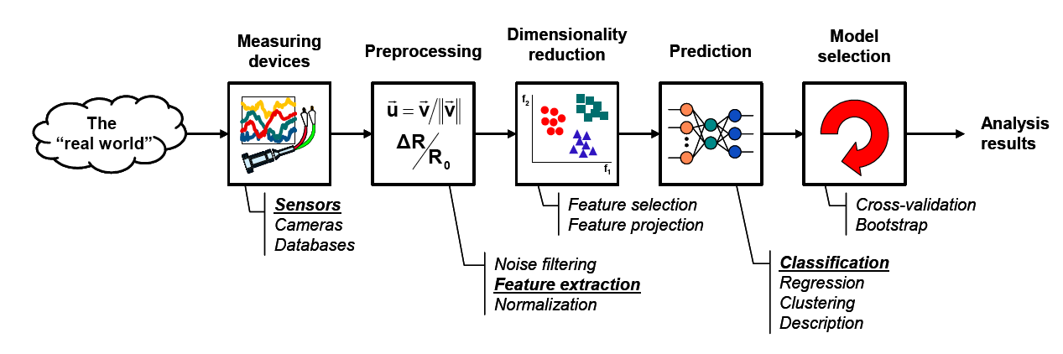
The learning process

